Slide 1


India & Neighbours
PPG Bilateral Lending 2000 - 2020
By Sahil Kumar Sharma

Slide 2
What is PPG Bilateral Debt?
Public and publicly guaranteed debt comprises long-term external obligations of public debtors.
It includes debt guaranteed by the national government, Public Corporations, State Owned Enterprises, Development Banks and other Mixed Enterprises, political subdivisions (or an agency of either), autonomous public bodies, and external obligations of private debtors that are guaranteed for repayment by a public entity.
External indebtedness affects a country's creditworthiness and investor perceptions.
Total debt service is contrasted with countries' ability to obtain foreign exchange through exports of goods, services, primary income, and workers' remittances.

Slide 3
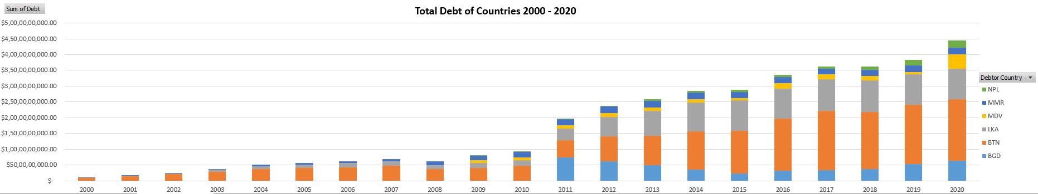
India & Neighbouring Countries PPG Bilateral Lending 2000 - 2020
Between the years 2000 – 2007, YoY growth has been minimal and steady
2008 shows a drop in lending due to Economic Crisis of 2008
YoY growth has been maximum from the year 2010 onwards

Slide 4
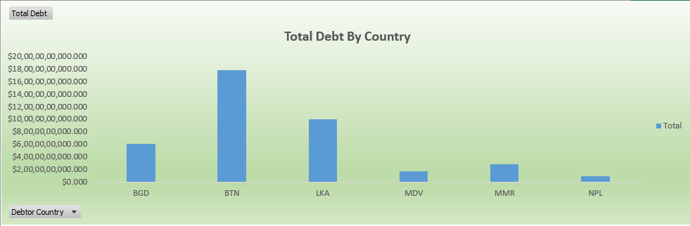
India & Neighbouring Countries PPG Bilateral Lending 2000 – 2020
Total Debt By Country
Bhutan has highest share of bilateral loans amounting to approx. 18 billion US$
Nepal has least share of bilateral loans amounting to approx. 1 billion US$
Total bilateral lending by India amounts to approx. 45 billion US$

Slide 5
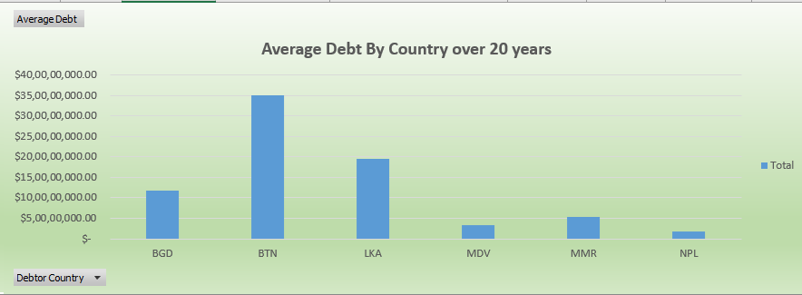
India & Neighbouring Countries PPG Bilateral Lending 2000 – 2020
Average Debt By Country over 20 years
Bhutan has highest share of bilateral loans amounting to approx. 3.5 billion US$ each year
Nepal has least share of bilateral loans amounting to approx. 250 million US$ each year
Average bilateral lending by India amounts to approx. 13 billion US$ over 20 years

Slide 6
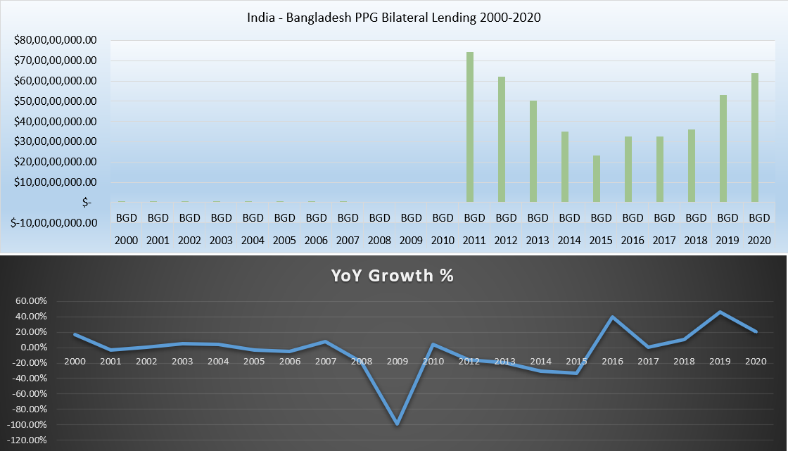
India – Bangladesh PPG Bilateral Lending 2000 - 2020
Total debt of Bangladesh amounts to approx. 6 billion US$
Bilateral lending has dramatically increased after 2010, slowing again till 2015

Slide 7
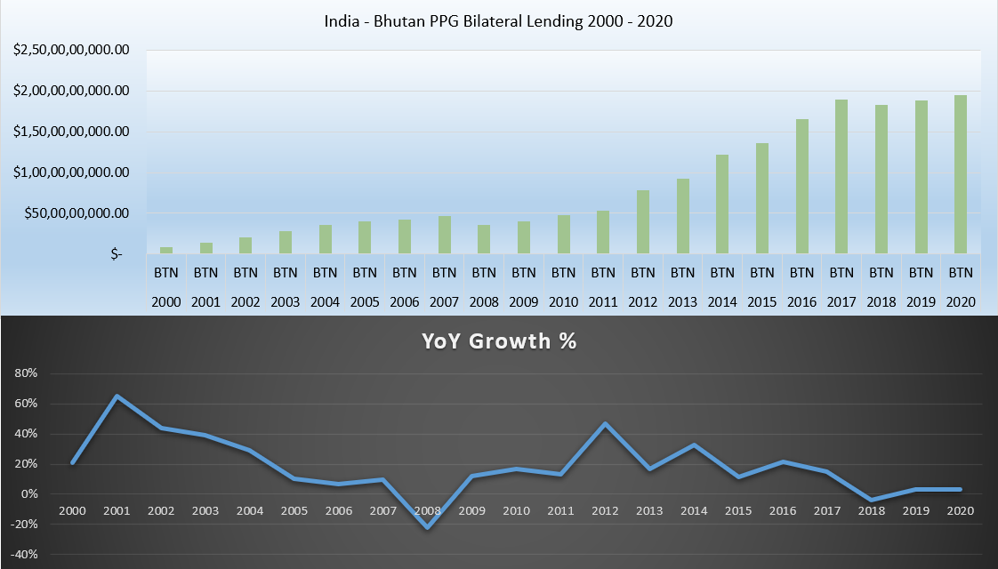
India – Bhutan PPG Bilateral Lending 2000 - 2020
Total debt of Bhutan amounts to approx. 18 billion US$
Bilateral lending has steadily increased over the years

Slide 8
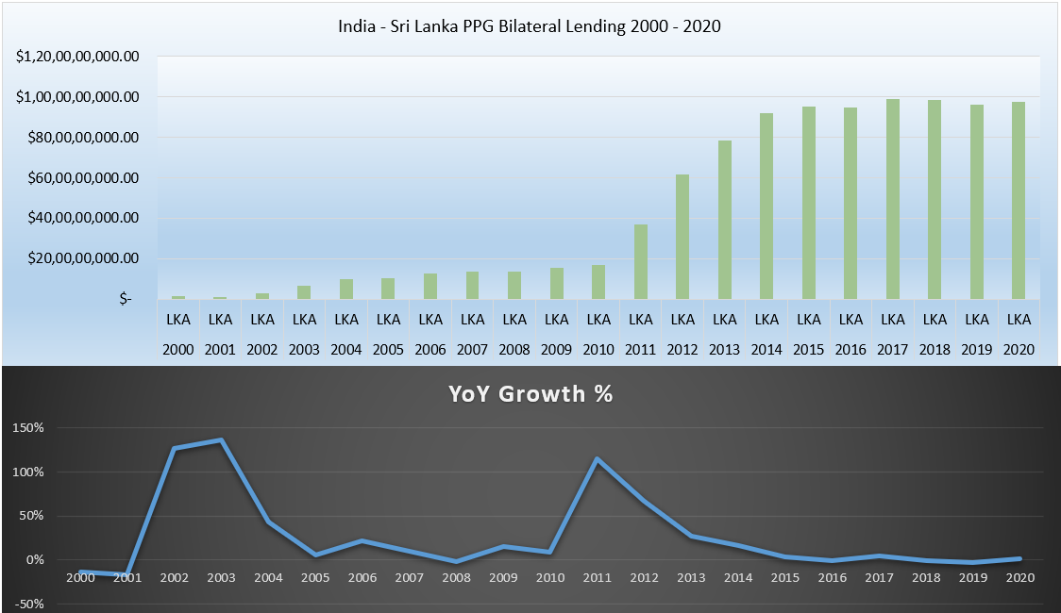
India – Sri Lanka PPG Bilateral Lending 2000 - 2020
Total debt of Sri Lanka amounts to approx. 9.5 billion US$
Bilateral lending has rapidly increased during 2010 – 2015 and remained constant till 2020

Slide 9
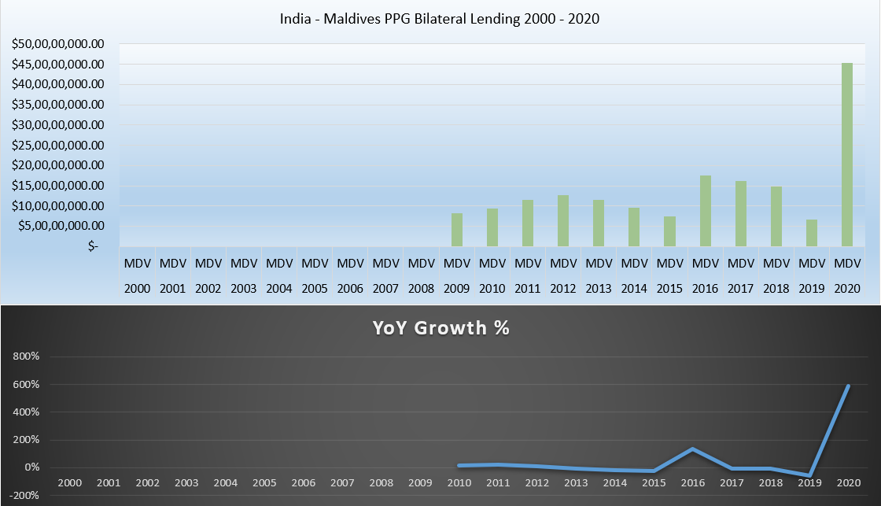
India – Maldives PPG Bilateral Lending 2000 - 2020
Total debt of Maldives amounts to approx. 1.8 billion US$
Bilateral lending has rapidly increased after 2008 and huge spike in 2020

Slide 10
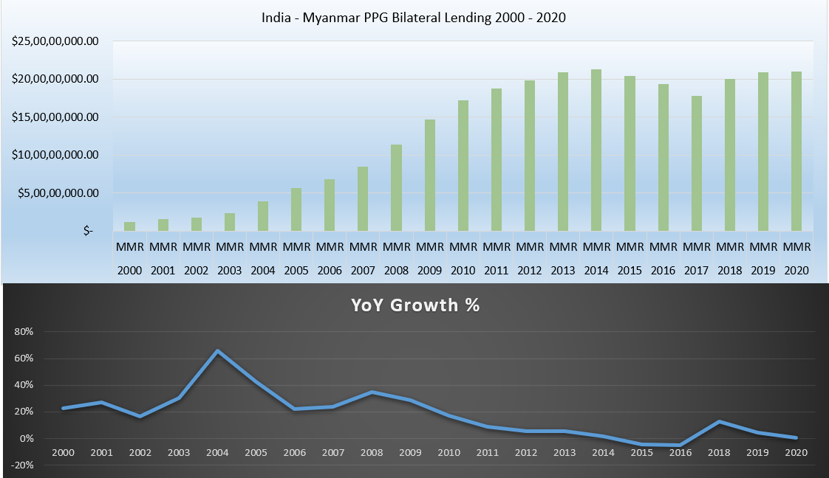
India – Myanmar PPG Bilateral Lending 2000 - 2020
Total debt of Myanmar amounts to approx. 2.8 billion US$
Bilateral lending has steadily increased since 2000 with small dip during 2015 - 2017

Slide 11
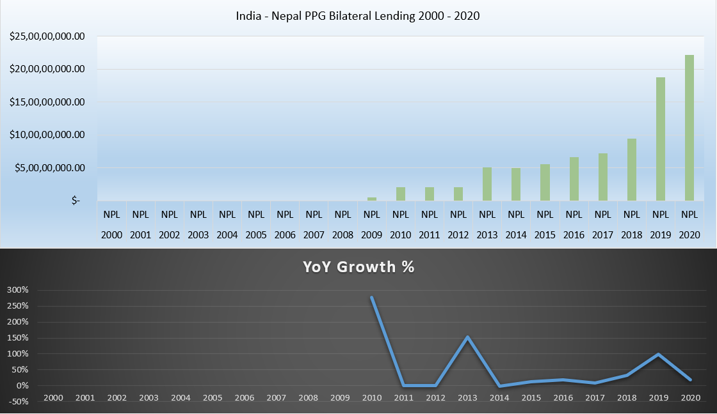
India – Nepal PPG Bilateral Lending 2000 - 2020
Total debt of Nepal amounts to approx. 90 million US$
Bilateral lending has rapidly increased after 2008

Slide 12
Conclusion
Total PPG Bilateral Lending has increased from less than 500 million $ in 2000 to about 45 billion $ in 2020
Bhutan has been the biggest debtor country receiving almost 18 billion $ over the period of 20 years
Nepal has received the least bilateral lending amounting to less than 1 billion $
Total bilateral lending show a positive growth rate since last 20 years
Total bilateral lending to neighbouring countries is approx. 1.2% of overall GDP of India
In the event of default by any neighboring country in future, its impact on India’s financial sector will be minimal

